Slide 1

UNIT-4

Slide 2
  Trees
  Binary Trees
  Terminology
  Representation
  Tree Traversals(in-order, pre-order, post-order)
  Binary Search Tree
    Insertion
    Deletion
    Display
  AVL Tree
    Insertion
    Deletion
    Search

Slide 3
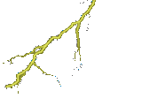















Trees

Slide 4
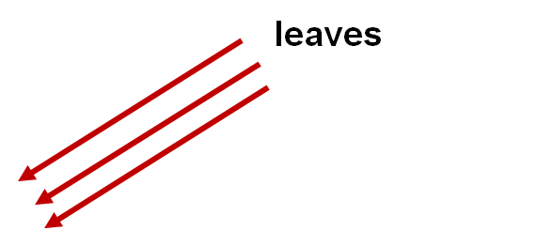

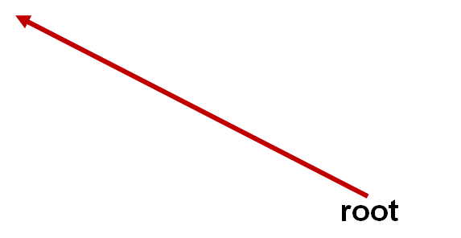
General View of a Tree

Slide 5

Computer Scientist’s View
root
leaves
branches
nodes
Notes:
Branches meet at nodes.

Slide 6
Tree
A tree, is a finite set of nodes together with a finite set of directed edges(links/branches) that define parent-child (Hierarchical )relationships.
Example:
Nodes = {A,B,C,D,E,F,G,H}
Edges = {(A,B),(A,E),(B,F),(B,G),(B,H),(E,C),(E,D)}
A tree is a finite set of one or more nodes such that:
  There is a specially designated node called the root.
  Remaining nodes are partitioned into ‘n’ (n>0) disjoint sets
  T1,T2,..Tn, where each Ti (i=1,2,….n) is a Tree, T1,T2,..Tn are called sub tree of the root.
Tree is a non-linear data structure.
A
E
B
D
C
F
H
G

Slide 7
A tree satisfies the following properties:
  It has one designated node, called the root, that has no parent.
  Every node, except the root, has exactly one parent.
  A node may have zero or more children.
  There is a unique directed path from the root to each node.
5
5
5
1
3
2
3
2
3
2
4
1
6
4
6
4
1
6
tree
Not a tree
Not a tree

Slide 8
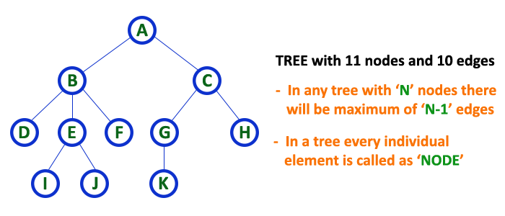
Tree Terminology
Root: Only node which has no parent
Edge: The connecting link between any two nodes is called as EDGE
Parent :The node which is predecessor of any node is called as PARENT NODE
Child : The node which is descendant of any node is called as CHILD Node
Siblings: Nodes which belong to same Parent are called as SIBLINGS.
Leaf or External Node: A node which has no children.
Non-leaf or Internal Node:the node which has at least one child
Path: A sequence of connected nodes.
Ancestor of x: Any node in the path from the root to x.
Descendent of x: Any node in the path from x to a leaf.
Empty Tree: A tree with no nodes.
Example: A

Slide 9
The level of a node x: It is the distance from the root to node x.
Generally, the root has a zero distance from itself, the root is at level 0.
The, children of the root are at level 1, their children are at level at 2, and so on.
Height of a node: is the number of edges from the node to the deepest leaf
Height of Tree: The maximum number of edges covered in a path
starting from root node to a leaf node is called height of a tree.
Depth: Length of the path to that node from the root.
Degree/arity of node x: Number of children's of a node x.
Degree of c: 3
Level 0
Level 1
Level 2
Level 3
Level 4
A
A
B
C
D
E
F
G
H
I
J
k

Slide 10
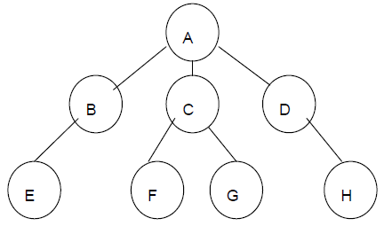
Example 2:

Slide 11
Tree Definition
Root
Subtrees of the root

Slide 12
Tree Terminology
Interior nodes
Root
Leaf nodes

Slide 13
Level of a Node
Level 0
Level 1
Level 2
Level 3

Slide 14
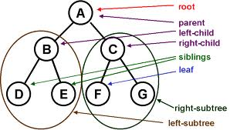

Slide 15
TERM | DESCRIPTION | EXAMPLE
Node | An item or single element represented in a tree | A,B,C…….,H
Root | Node that does not have any ancestors (parent or Grandparent) | A
Sub tree | Internal nodes in a tree which has both ancestor(parent) and descendant(child) | B,C,D
Leaf | External nodes that does not have any descendant(child) | E,F,G,H
Edge | The line depicts the connectivity between two nodes | (A-B),(A-C)…
Path | Sequence of nodes connected | A-B-E for E from root
Height | Length of the longest path from the root | 3
Depth | Length of the path to that node from the root | 2 for D
Degree of a node | Number of children connected from that node | 3 for A, 1 for B,D, 2 for C and 0 for leaves
Degree of a tree | Degree of a node which has maximum degree | 3 (since A has Max. degree)

Slide 16
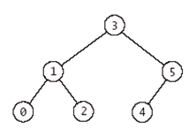
Binary Tree
In a binary tree, each node has at most two sub trees.
A binary tree(T) is a finite set of nodes such that:
→ T is empty tree (called empty binary tree)
→ T contains a specially designed node called the root of T, and remaining nodes of T form two disjoint binary trees T₁ and T₂ which are called left sub tree and right sub tree respectively.
Note: A binary tree is a tree in which no nodes can have more than two children.

Slide 17
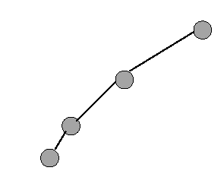
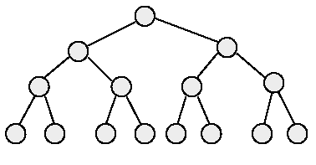
Binary Tree Properties
A binary tree with n elements, n > 0, has exactly n-1 edges.
A binary tree of height h, h >= 0, has at least h+1 and at most 2^{h+1}-1 elements or nodes in it.
The height of a binary tree that contains n elements (n>=0) is atleast
log(n+1) and at most n
Minimum and Maximum number of elements for height 4
minimum number of elements
maximum number of elements

Slide 18
Difference between tree and binary tree
Trees
1) A node may have any no of nodes/children’s.
Binary tree
1) A node may have at most 2 children's or 0 or1 children.

Slide 19
Full binary tree
A full binary tree is a tree in which every node other than the leaves has two children.
A full binary tree of height h has exactly 2^{h+1}-1 nodes.
1
Level 0- 1node
2
3
Level 1- 2nodes
4
5
6
7
Level 2- 4nodes
10
12
13
14
15
Level 3-8nodes
8
9
11

Slide 20
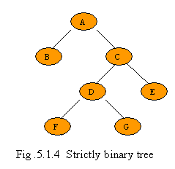
18 / \ 15 20 / \ 40 50 / \ 30 50
18 / \ 15 20 / \ 40 50 / \ 30 50
18
15 30
40 50 100 40
18
15 20
40 50 30 50
15
30 60
18
40 30
100 50

Slide 21
Complete binary tree
A complete binary tree is a binary tree in which every level is completely
filled except possibly the last level.
In the unfilled level, the nodes are attached starting from the left-most position.
1
Level 0- 1node
2
3
Level 1- 2 nodes
4
5
6
7
Level 2- 4 nodes
8
9
Level 3- 2 nodes

Slide 22
Balanced Binary Tree
Balanced binary tree is a binary tree in which the left and right sub trees
height must be differed by at most 1.
1
2
3
Left sub tree height =2
Right sub tree height = 1
4
5
6
7
Difference = 1
8
9

Slide 23
Left skewed binary tree
If the right subtree is missing in every node of tree then we call it as left skewed tree.
Right skewed binary tree
If the left subtree is missing in every node of a tree then we call it is right subtree.
A
B
C
A
B
C

Slide 24
Representation of a Binary Tree using Array
Sequential Representation :
→ Tree nodes are stored in a linear data structure like array.
→ Root node is stored at index ‘0’
→ If a node is at a location ‘i’, then its left child is located at 2 * i + 1 and right child is located at 2 * i + 2
The space required by a binary tree of height h is 2^{h+1}-1.

Slide 25
Example: Sequential representation
0
A
1
2
B
D
3
5
G
6
C
E
F
12
A B D C . E G . . . . . F
0 1 2 3 4 5 6 7 8 9 10 11 12 13 14

Slide 26
Disadvantages of Static Representation
Advantages of array/sequential/static representation
Any node can be accessed from any other node by calculating the index and this is efficient from execution point of view.
There is no overhead of maintaining the pointers.
The major disadvantage with this type of representation is wastage of memory. Example: In the skewed tree, half of the array is unutilized.
Allows only static representation. There is no possible way to enhance the size of the tree.
Inserting a new node and deleting a node from it are inefficient with this representation because these require considerable data movement up and down the array which demand excessive processing time.

Slide 27
Representation of Binary Tree using Linked List
The most popular way to present a binary tree.
Each element is represented by a node that has two link fields (leftChild and rightChild) plus an element field .
The space required by an n node binary tree is n * sizeof a node.
struct node { /* a node in the tree structure */
struct node *left;
int data ;
struct node *right;
};
→The pointer left stores the address of left child node.
→The pointer right stores the address of right child node.
→If child is not available NULL is stored.
→A pointer variable root represents the root of the tree.

Slide 28
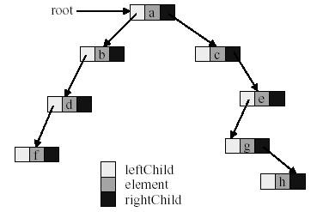
Linked Representation of Binary Tree

Slide 29
Advantages of linked representation
This representation is superior to the array representation as there is no wastage of memory.
There is no need to have prior knowledge of depth of the tree. Using dynamic memory allocation concept one can create as much memory (node) as required.
Insertion and deletion which are the most common operations can be done without moving the other nodes.
Disadvantages of linked representation
This representation does not provide direct access to a node.
It needs additional space in each node for storing the left and right subtrees.

Slide 30
Binary Tree Traversal Techniques
There are three recursive techniques for binary tree traversal.
1. Preorder Traversal
2. Inorder Traversal
3. Postorder Traversal

Slide 31
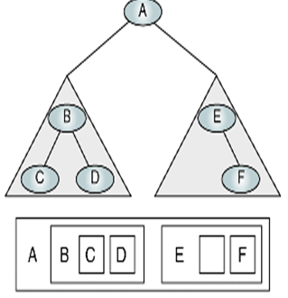
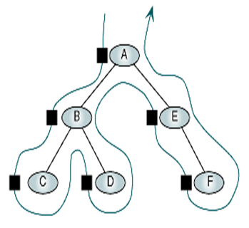
Algorithm preOrder (root)
Traverse a binary tree in root-left-right
Pre Condition: root is the entry node of a tree or subtree
Post Condition: each node has been processed in order
1. if(root is not null)
1. process(root)
2. preOrder(leftsubtree)
3. preOrder(rightsubtree)
2. end if
end preOrder

Slide 32
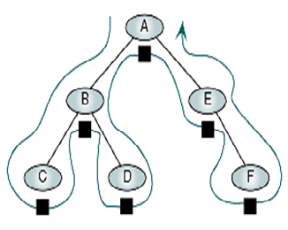
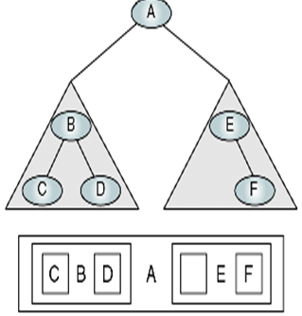
Algorithm inOrder (root)
Traverse a binary tree in left-root-right
Pre Condition: root is the entry node of a tree or subtree
Post Condition: each node has been processed in order
1. if(root is not null)
1. inOrder(leftsubtree)
2. process(root)
3. inOrder(rightsubtree)
2. end if
end inOrder

Slide 33
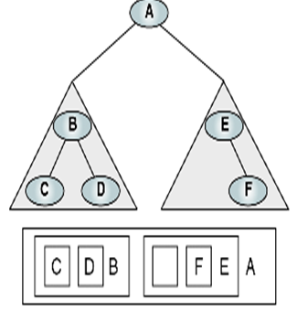
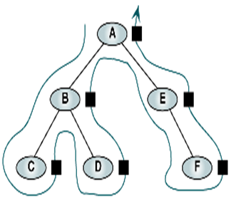
Algorithm postOrder (root)
Traverse a binary tree in left-right-root
Pre Condition: root is the entry node of a tree or subtree
Post Condition: each node has been processed in order
1. if(root is not null)
1. postOrder(leftsubtree)
2. postOrder(rightsubtree)
3. process(root)
2. end if
end postOrder

Slide 34
Preorder of binary tree
A
B
C
D
E
F
G
H
J
I
K
Preorder: A B D E H I C F J K G

Slide 35
Inorder of binary tree
A
B
C
D
E
F
G
H
J
I
K
Inorder: D B H E I A F K J C G

Slide 36
Postorder of binary tree
A
B
C
D
E
F
G
H
J
I
K
Postorder: D H I E B K J F G C A

Slide 37
Write pre,in and post order of the following tree:
(A-B) + C* (D/E)
+
-
*
A
B
C
/
D
E

Slide 38
Preorder for the following tree
+
-
*
A
B
C
/
D
E
Preorder: + - A B * C / D E

Slide 39
Inorder of the following tree
+
-
*
A
B
C
/
D
E
Inorder: A - B + C * D / E

Slide 40
Postorder of the following tree
+
-
*
A
B
C
/
D
E
Postorder: A B - C D E / * +

Slide 41
Binary Search Tree

Slide 42
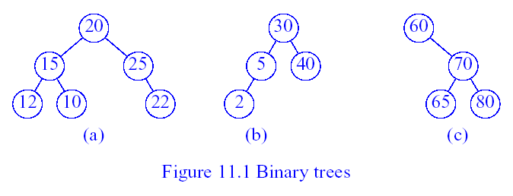
Binary Search Tree
A binary search tree is a nonempty binary tree that satisfies the following
properties:
  Each node has a key/element (or value), and no two nodes have the same key (i.e., all keys are distinct).
  For every node x, all keys/elements in the left sub tree of x are smaller than x.
  For every node x, all keys in the right sub tree of x are larger than x.
  The left and right sub trees of the root are also binary search trees.
Fig (a) is not a BST where as Fig (b) and (c) are BST’s

Slide 43
Binary Search Tree Operations
1. Searching:
Search begins at the root.
If the root is NULL, the search tree is empty and the search fails.
If key is less than the root, then left subtree is searched.
If key is greater than the root, then right subtree is searched.
If key equals the root, then the search terminates successfully.
20
Search for 8
10
40
6
15
30
2
8
25

Slide 44
2.Insertion:
Binary Search Tree Operations
To insert a new element into a binary search tree, we must first verify that its key does not already exist by performing a search in the tree.
If the search is successful, we do not insert.
If the search is unsuccessful, then the element is inserted at the point the search terminated.
Insert 35
20
10
40
6
15
30
2
8
25
35

Slide 45
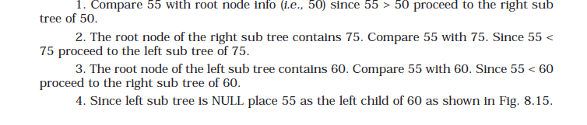
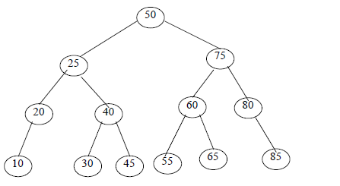
55

Slide 46
3.Deletion:
Binary Search Tree Operations
There are three cases for the element to be deleted:
  Element is in a leaf.
  Element is in a degree 1 node (i.e., has exactly one nonempty subtree).
  Element is in a degree 2 node (i.e., has exactly two nonempty subtrees).
Case 1: Delete from a Leaf.
For case 1, we can simply discard the leaf node.
Example, delete a leaf element. Key = 7.
20
10
40
6
15
30
2
8
18
25
35
7

Slide 47
Case 2: Delete from a Degree 1 Node
Deleted node has only one child, check whether it is a right child or left child
If it is a left child, then find the Largest element from the corresponding left
sub tree. Then replace the largest node information with the deleted node.
20
Delete 40
10
40
6
15
30
2
8
18
25

Slide 48
Case 2: Delete from a Degree 1 Node
Deleted node has only one child, check whether it is a right child or left child
If it is a right child, then find the smallest element from the corresponding right
sub tree. Then replace the smallest node information with the deleted node.
20
10
Delete 15
6
15
30
2
8
18
25

Slide 49
Case 3: Delete from a Degree 2 Node(it has both left and right child)
Replace with the largest key in the left subtree or the smallest in the right subtree)
20
10
40
6
15
30
2
8
18
25
35
7
20
8
40
6
15
30
2
7
18
25
35

Slide 50
Replace with the smallest in the right subtree)
20
10
40
6
15
30
2
8
18
25
35
7
20
15
40
6
18
30
2
7
25
35

Slide 51
/* Write a C program that uses functions to perform the following:
i) Creating a Binary search Tree of integers.
ii) Traversing the above binary tree in preorder, inorder and postorder.*/
bnode* insert(bnode*,int);
bnode* delet(bnode*,int);
int search(bnode*,int);
bnode* findmax(bnode*);
void preorder(bnode*);
void inorder(bnode*);
void postorder(bnode*);
#include <stdio.h>
#include<stdlib.h>
struct node
{
int data;
struct node *left,*right;
}*new,*root,*q;
typedef struct node bnode;

Slide 52
void main()
{
int ch, ele;
root = NULL;
printf("\n Binary Search Tree Operations :");
while(1)
{
printf("\n\t 1.insert 2 .Delete 3. search 4. pre 5.in 6.post 7->exit \n");
printf("\n Enter your choice :");
scanf("%d", &ch);
switch(ch)
{
case 1: printf("\n Enter an element :");
scanf("%d", &ele);
root = insert(root, ele); break;
case 2: printf("\n Enter element to be deleted:");
scanf("%d",&ele);
root = delet(root,ele);
break;

Slide 53
case 3: printf("\n Enter element to search:");
scanf("%d",&ele);
if(search(root,ele))
printf("\n ELement found ");
else
printf("\n Element not found");
break;
case 4: preorder(root); break;
case 5: inorder(root); break;
case 6: postorder(root); break;
case 7: exit(0);
default : printf("\n Invalid choice.");
}//switch
}//while
}//main

Slide 54
void postorder(bnode *root)
{
if(root)
{
postorder(root->left);
postorder(root->right);
printf("%5d",root->data);
}
}
void preorder(bnode *root)
{
if(root)
{
printf("%5d",root->data);
preorder(root->left);
preorder(root->right);
}
}
void inorder(bnode *root)
{
if (root)
{
inorder(root->left);
printf("%5d",root->data);
inorder(root->right);
}
}
int search(bnode *root,int ele)
{
if(root)
{
if(root -> data == ele)
return 1;
else if(ele<root -> data )
return search(root->left,ele);
else
return search(root->right,ele);
}
return 0;
}

Slide 55
bnode* insert(bnode *root, int ele)
{
if(root==NULL)
{
new=malloc(sizeof(bnode));
new->data=ele;
new->left=NULL; new->right=NULL;
root = new;
}
else if(ele>root->data )
root->right = insert(root->right, ele);
else if(ele<root -> data )
root -> left = insert(root -> left, ele);
else
{
printf("\n Duplicate data ");
}
return root;
}

Slide 56
bnode* delet(bnode* root,int ele){
if(root){
if(ele>root->data )
root ->right = delet(root->right,ele);
else if(ele<root ->data )
root -> left = delet(root->left,ele);
else
{
if(root->left && root->right)
{ q = findmax(root->left);
root->data = q->data;
root->left=delet(root->left,q->data);}
else if(root->left)
root = root -> left;
else
root = root -> right;
}
}
return root; }
bnode* findmax(bnode *root)
{
if( root -> right == NULL)
return root;
else
return findmax(root->right);
}

Slide 57
Applications of Trees
Trees are very important data structures in computing.
They are suitable for:
  Hierarchical structure representation, e.g.,
    File directory.
    Organizational structure of an institution.
    Class inheritance tree.
  Problem representation, e.g.,
    Expression tree.
    Decision tree.
  Efficient algorithmic solutions, e.g.,
    Search trees.
    Efficient priority queues via heaps.

Slide 58
AVL Trees

Slide 59

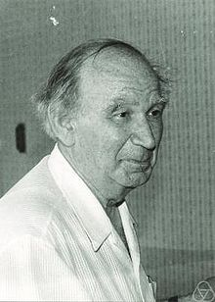
AVL (Georgy Adelson-Velsky and Evgenii Landis’) TREE
Inventors of AVL as Self Balancing binary search tree

Slide 60
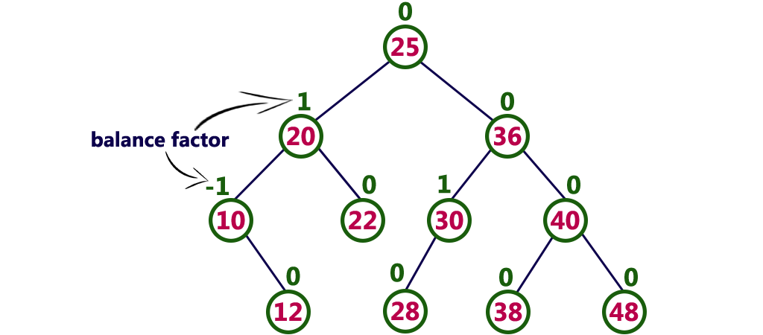
AVL Trees
AVL tree
An AVL tree is balanced binary search tree. In an AVL tree
Balance factor of every node is either -1,0 or +1.
Balance factor of a node is the difference between height s of
left and right sub trees of that node

Slide 61
Binary Search Trees
5
7
2
8
8
2
1
4
7
1
4
3
3
5
Both are binary search trees, which is an AVL tree?

Slide 62
AVL TREE operations
Searching
Insertion
Deletion

Slide 63
Searching
Search begins at the root.
If the root is NULL, the search tree is empty and the search fails.
If key is less than the root, then left subtree is searched.
If key is greater than the root, then right subtree is searched.
If key equals the root, then the search terminates successfully.
20
10
40
6
15
30
2
8

Slide 64
Insertion
To insert a new element into a AVL tree, we must first verify that its key does not already exist by performing a search in the tree.
If the search is successful, we do not insert.
If the search is unsuccessful, then the element is inserted at the point the search terminated.
After performing operation, we need to check whether tree is balanced or not
If tree is imbalanced due to any operation, we use rotation operations to make the tree balanced
To make itself balanced, AVL tree may perform four kinds of rotations
Single rotation
Left rotation
Right rotation
Double rotation
Left-Right rotation
Right-Left rotation

Slide 65
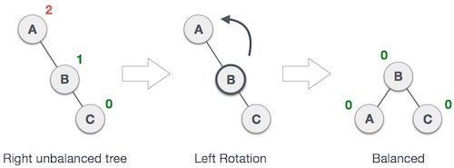
Left Rotation
If a tree becomes unbalanced, when a node is inserted into the right subtree of the right subtree, then we perform a single left rotation

Slide 66
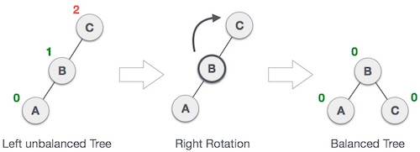
Right Rotation
If a tree becomes unbalanced, when a node is inserted into the left subtree of the left subtree, then we perform a single right rotation

Slide 67

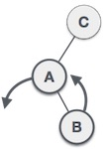
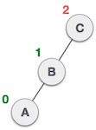
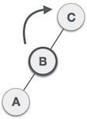
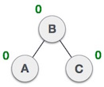
Left-Right Rotation
If a tree becomes unbalanced, when a node is inserted into the right subtree of the left subtree, then we perform a left- right rotation

Slide 68

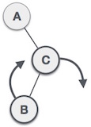
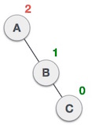
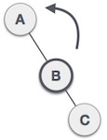
Right-Left Rotation
If a tree becomes unbalanced, when a node is inserted into the left subtree of the right subtree, then we perform a right-left rotation

Slide 69
AVL Balancing : Four Rotations
k3
k3
k2
LR
k2
k2
k1
Single right
k1
k3
k1
k2
k1
k3
k1
k1
k2
k2
Single left
RL
k2
k3
k1
k3
k1
k3
k3
k2

Slide 70

Single left Rotation
We want k₂ as the new root.
  Pretend the tree is flexible, grab hold of k₂, letting gravity take hold.
  k1< k₂ (by BST property), so k1 becomes k₂’s left subtree.
  A ,C and D can remain attached to the same point,
  And B becomes k₁’s right subtree to maintain BST property.
k₁
k₂
k₂
_{A}
k₁
k₃
_{B}
k₃
_{A}
_{B}
_{C}
_{D}
_{C}
_{D}

Slide 71
Single right Rotation
We want k₂ as the new root.
  Pretend the tree is flexible, grab hold of k₂, letting gravity take hold.
  k₃ > k₂ (by BST property), so k₃ becomes k₂’s right subtree.
  A ,B and D can remain attached to the same point,
  And C becomes k₃’s left subtree to maintain BST property.
k₃
k₂
k₂
D
k₁
k₃
k1
c
A
B
C
D
A
B

Slide 72
Double Left-Right Rotation
  A and D can remain attached to the same point.
  B becomes k₁’s right subtree to maintain BST property
  C becomes k₃’s left subtree to maintain BST property
k₃
k₃
Single Left Rotation at K₁
k₁
D
k₂
D
k₂
k₁
A
C
B
C
A
B
k₂
Single Right Rotation at K₃
k₁
k₃
A
B
C
D

Slide 73
Double Right-left Rotation
  A and D can remain attached to the same point.
  B becomes k₁’s right subtree to maintain BST property
  C becomes k₃’s left subtree to maintain BST property
k₁
k₁
Single right Rotation at K₃
k₂
A
k₃
A
k₃
B
k₂
D
C
D
k₂
B
Single left Rotation at K1
C
k₁
k₃
A
B
C
D

Slide 74
AVL Tree Rotations
Single right rotations examples:
20,18,12
18,12,20,8,14,4
Single left rotations examples:
12,18,20
14,12,20,18,23,44
Double left- right rotations examples:
12,4,8
23,18,44,12,20,52,4,14,16
Double Right- left rotations examples:
12,44,18
18,12,44,23,52,20

Slide 75
AVL Tree Rotations
Single rotations: insert 14, 15, 16, 13, 12, 11, 10
First insert 14 and 15:
14
15
Now insert 16.

Slide 76
AVL Tree Rotations
Single rotations:
Inserting 16 causes AVL violation:
14
15
16
Need to rotate.

Slide 77
AVL Tree Rotations
Single rotations:
Rotation type:
14
15
16

Slide 78
AVL Tree Rotations
Single rotations:
Rotation restores AVL balance:
15
14
16

Slide 79
AVL Tree Rotations
Single rotations:
Now insert 13 and 12:
15
14
16
13
12
AVL violation - need to rotate.

Slide 80
AVL Tree Rotations
Single rotations:
Rotation type:
15
14
16
13
12

Slide 81
AVL Tree Rotations
Single rotations:
15
13
16
12
14
Now insert 11.

Slide 82
AVL Tree Rotations
Single rotations:
15
13
16
12
14
11
AVL violation – need to rotate

Slide 83
AVL Tree Rotations
Single rotations:
Rotation type:
15
13
16
12
14
11

Slide 84
AVL Tree Rotations
Single rotations:
13
12
15
14
16
11
Now insert 10.

Slide 85
AVL Tree Rotations
Single rotations:
13
12
15
14
16
11
10
AVL violation – need to rotate

Slide 86
AVL Tree Rotations
Single rotations:
Rotation type:
13
12
15
14
16
11
10

Slide 87
AVL Tree Rotations
Single rotations:
13
11
15
10
12
14
16
AVL balance restored.

Slide 88
AVL Tree Rotations
Double rotations: insert 1, 2, 3, 4, 5, 7, 6, 9, 8
First insert 1 and 2:
13
11
15
10
12
14
16

Slide 89
AVL Tree Rotations
Double rotations:
AVL violation - rotate
13
11
15
14
16
10
12
1
2

Slide 90
AVL Tree Rotations
Double rotations:
Rotation type:
13
11
15
14
16
10
12
1
2

Slide 91
AVL Tree Rotations
Double rotations:
AVL balance restored:
13
11
15
2
12
14
16
1
10
Now insert 3.

Slide 92
AVL Tree Rotations
Double rotations:
AVL violation – rotate:
13
11
15
2
12
14
16
1
10
3

Slide 93
AVL Tree Rotations
Double rotations:
Rotation type:
13
11
15
2
12
14
16
1
10
3

Slide 94
AVL Tree Rotations
Double rotations:
AVL balance restored:
13
10
15
2
11
14
16
1
3
12
Now insert 4.

Slide 95
AVL Tree Rotations
Double rotations:
AVL violation - rotate
13
10
15
2
11
14
16
1
3
12
4

Slide 96
AVL Tree Rotations
Double rotations:
Rotation type:
13
10
15
2
11
14
16
1
3
12
4

Slide 97
AVL Tree Rotations
Double rotations:
10
2
13
1
3
11
15
4
12
14
16
Now insert 5.

Slide 98
AVL Tree Rotations
Double rotations:
10
2
13
1
3
11
15
4
12
14
16
5
AVL violation – rotate.

Slide 99
AVL Tree Rotations
Single rotations:
Rotation type:
10
2
13
1
3
11
15
4
12
14
16
5

Slide 100
AVL Tree Rotations
Single rotations:
AVL balance restored:
10
2
13
1
4
11
15
3
5
12
14
16
Now insert 7.

Slide 101
AVL Tree Rotations
Single rotations:
AVL violation – rotate.
10
2
13
1
4
11
15
3
5
12
14
16
7

Slide 102
AVL Tree Rotations
Single rotations:
Rotation type:
10
2
13
1
4
11
15
3
5
12
14
16
7

Slide 103
AVL Tree Rotations
Double rotations:
AVL balance restored.
10
4
13
2
5
11
15
7
12
14
16
1
3
Now insert 6.

Slide 104
AVL Tree Rotations
Double rotations:
AVL violation - rotate.
10
4
13
2
5
11
15
7
12
14
16
1
3
6

Slide 105
AVL Tree Rotations
Double rotations:
Rotation type:
10
4
13
2
5
11
15
7
12
14
16
1
3
6

Slide 106
AVL Tree Rotations
Double rotations:
AVL balance restored.
10
4
13
2
6
11
15
12
14
16
1
3
5
7
Now insert 9 and 8.

Slide 107
AVL Tree Rotations
Double rotations:
AVL violation - rotate.
10
4
13
2
6
11
15
12
14
16
1
3
5
7
9
8

Slide 108
AVL Tree Rotations
Double rotations:
Rotation type:
10
4
13
2
6
11
15
12
14
16
1
3
5
7
9
8

Slide 109
AVL Tree Rotations
Final tree:
Tree is almost perfectly balanced
10
4
13
2
6
11
15
12
14
16
1
3
5
8
7
9

Slide 110
Deletion from an AVL Tree
  1.If the node is a leaf, remove it.
  2.If node has only one child, check whether it is a right child or left child
If it is a left child, then find the Largest element from the corresponding left sub tree. Then replace the largest node information with the deleted node.
If it is a right child, then find the smallest element from the corresponding right sub tree. Then replace the smallest node information with the deleted node.
3.If Node has both left and right child, replace the deleted node with the largest key in the left subtree or the smallest in the right subtree.
4.After deletion, check whether tree is balanced or not .If tree is not balanced, perform rotation operations to make tree balanced.

Slide 111
Deletion from an AVL Tree
In an insert there is at most one node that needs to be rebalanced. But in a delete there may be multiple nodes to be rebalanced.
  Technically only one rebalance that happens at a node, but once that happens it may affect the ancestral nodes.

Slide 112
Deletion Example
Delete leaf node 8
32
16
48
8
24
40
56
28
36
44
52
60
58
62

Slide 113
Deletion Example
32
16
48
24
40
56
28
36
44
52
60
58
62

Slide 114
Deletion Example
32
32
24
48
48
16
16
28
40
56
56
36
44
52
60
58
62

Slide 115
Deletion Example
Delete non leaf node 32
Find smallest from corresponding right subtree(Replace 32 with 36)
48
32
56
24
40
52
60
16
58
62
16
28
36
44

Slide 116
Deletion Example
Delete non leaf node 32
48
36
56
24
40
52
60
16
58
62
16
28
44

Slide 117
Deletion Example
Delete non leaf node 40
It has only right child, find smallest from corresponding right subtree(Replace 40 with 44)
48
36
56
24
40
52
60
16
58
62
16
28
44

Slide 118
Deletion Example
Delete non leaf node 40
48
36
56
24
52
60
44
16
58
62
16
28

Slide 119
  15, 20, 24, 10, 13, 7, 30, 36, 25
20
15
15
24
20
10
24
13
20
20
13
24
15
24
10
15
13
10

Slide 120
  15, 20, 24, 10, 13, 7, 30, 36, 25
20
13
13
24
10
20
10
15
7
15
24
7
30
13
36
10
20
7
15
30
24
36

Slide 121
  15, 20, 24, 10, 13, 7, 30, 36, 25
13
13
10
20
10
20
7
15
30
7
15
24
24
36
30
25
13
25
36
10
24
7
20
30
15
25
36

Slide 122
  Remove 24 and 20 from the AVL tree.
13
13
10
24
10
20
7
20
30
7
15
30
15
25
36
25
36
13
13
10
30
10
15
7
15
36
7
30
25
25
36

